Slide 1

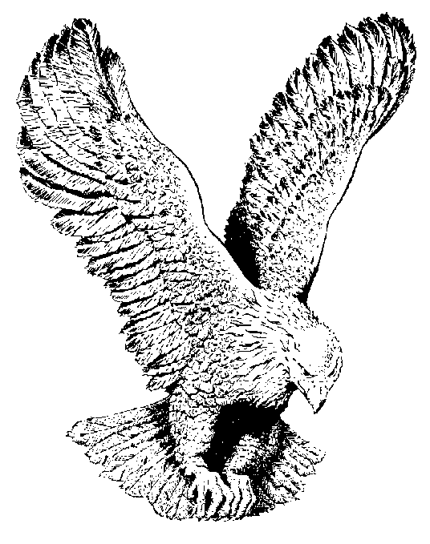
731 FAMILY OF GOD
I love this family of God
So closely knitted into one
They’ve taken me into their heart
And I’m so glad to be a part
Of this great family.

